Slide 1
EDA 과제
22026566
진우석

Slide 2
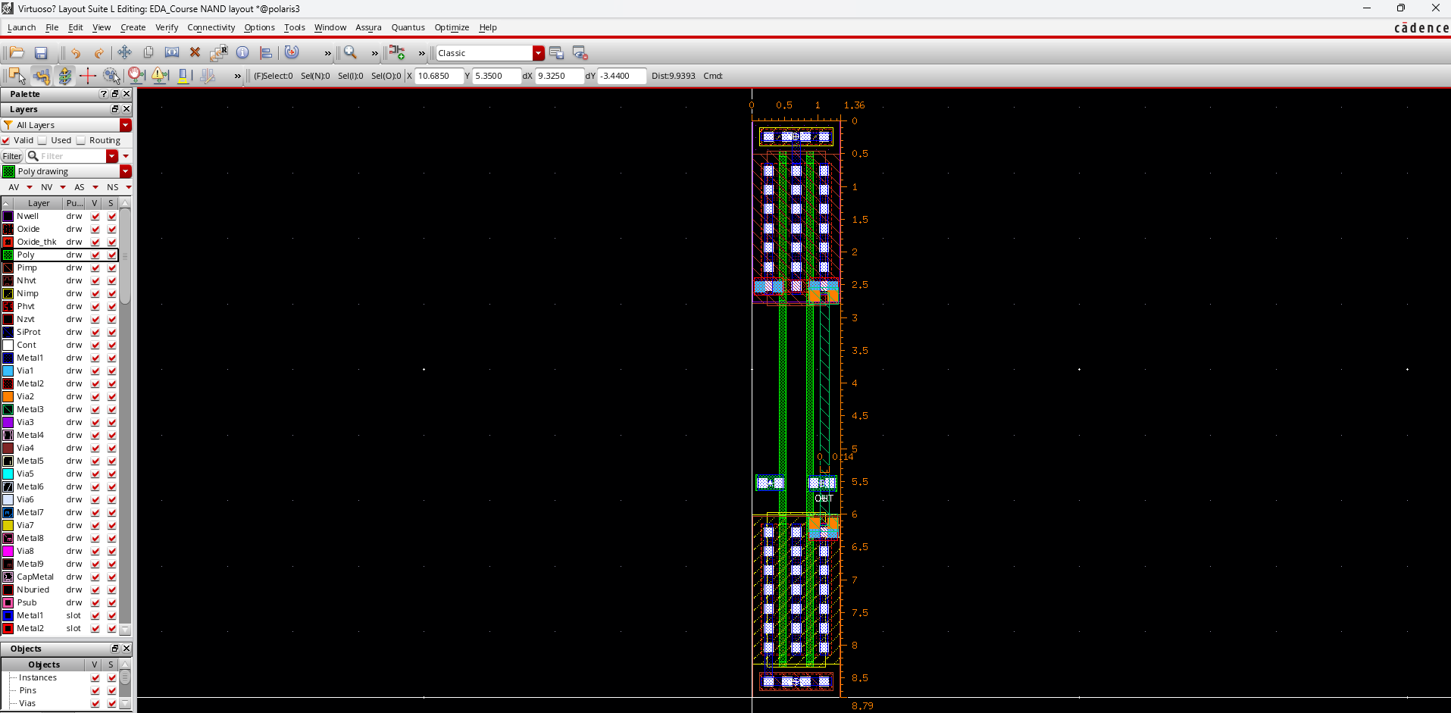
2 input NAND 경로:/home/analoguser42/EDA/EDA_Course
Library: EDA_Course
2 input NAND schematic : cell name ==> NAND, view name ==> layout
(가로X높이)
=(1.36X8.79)=11.95

Slide 3
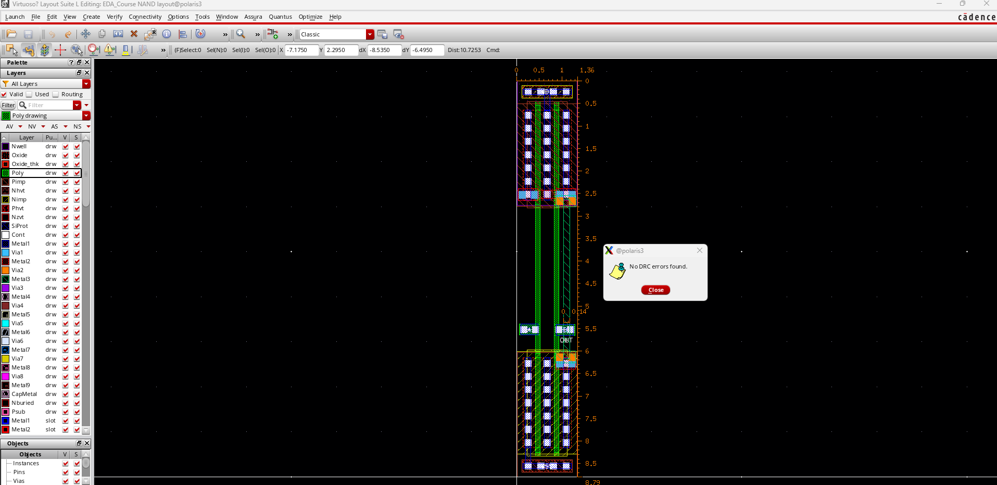
DRC 결과

Slide 4
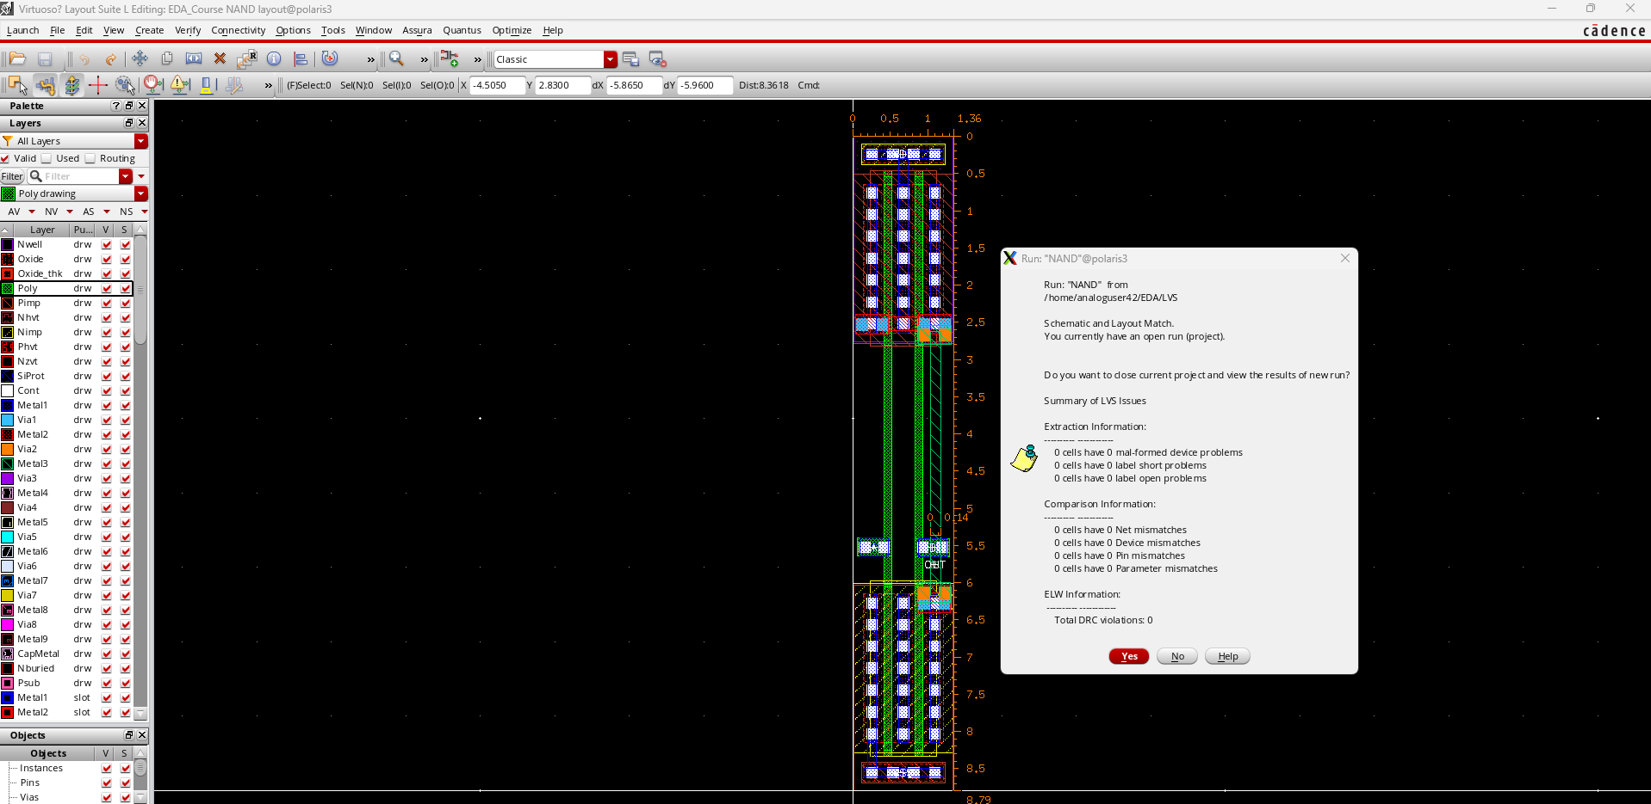
LVS 결과

Slide 5
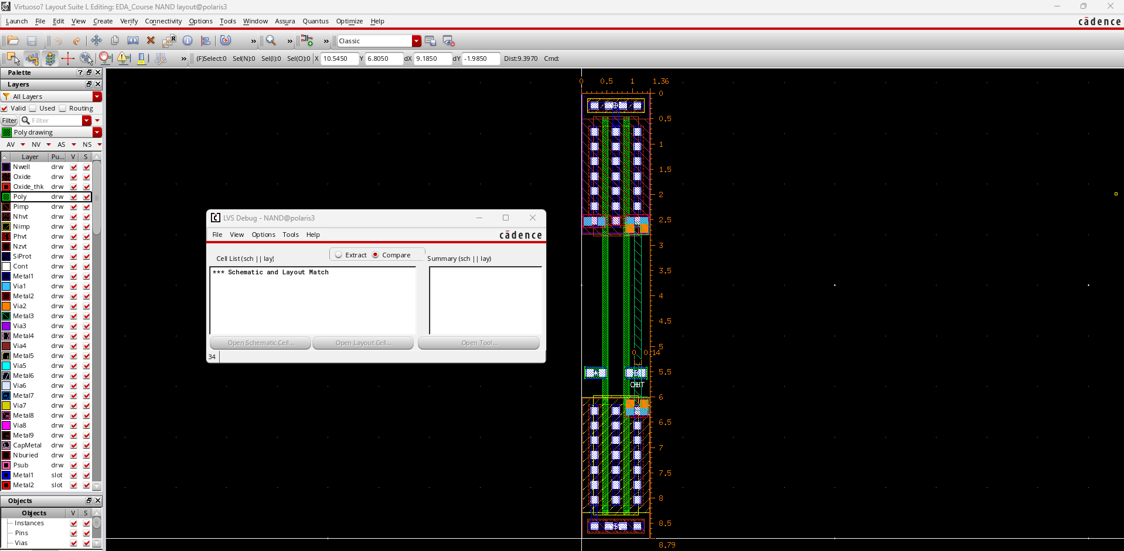
LVS 결과

Slide 6
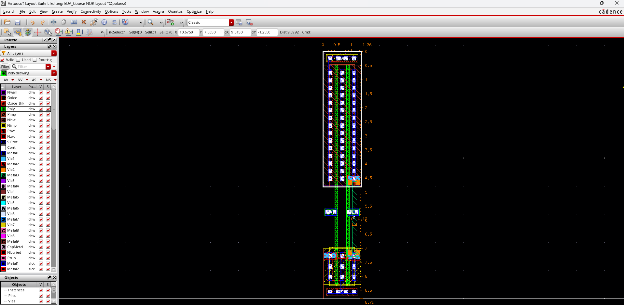
2 input NOR 경로:/home/analoguser42/EDA/EDA_Course
Library: EDA_Course
2 input NOR schematic : cell name ==> NOR, view name ==> layout
(가로X높이)
=(1.36X8.79)=11.95

Slide 7
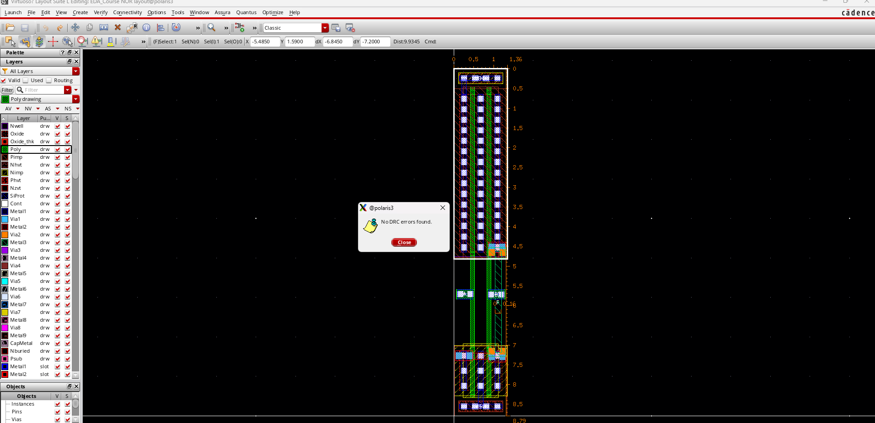
DRC 결과

Slide 8
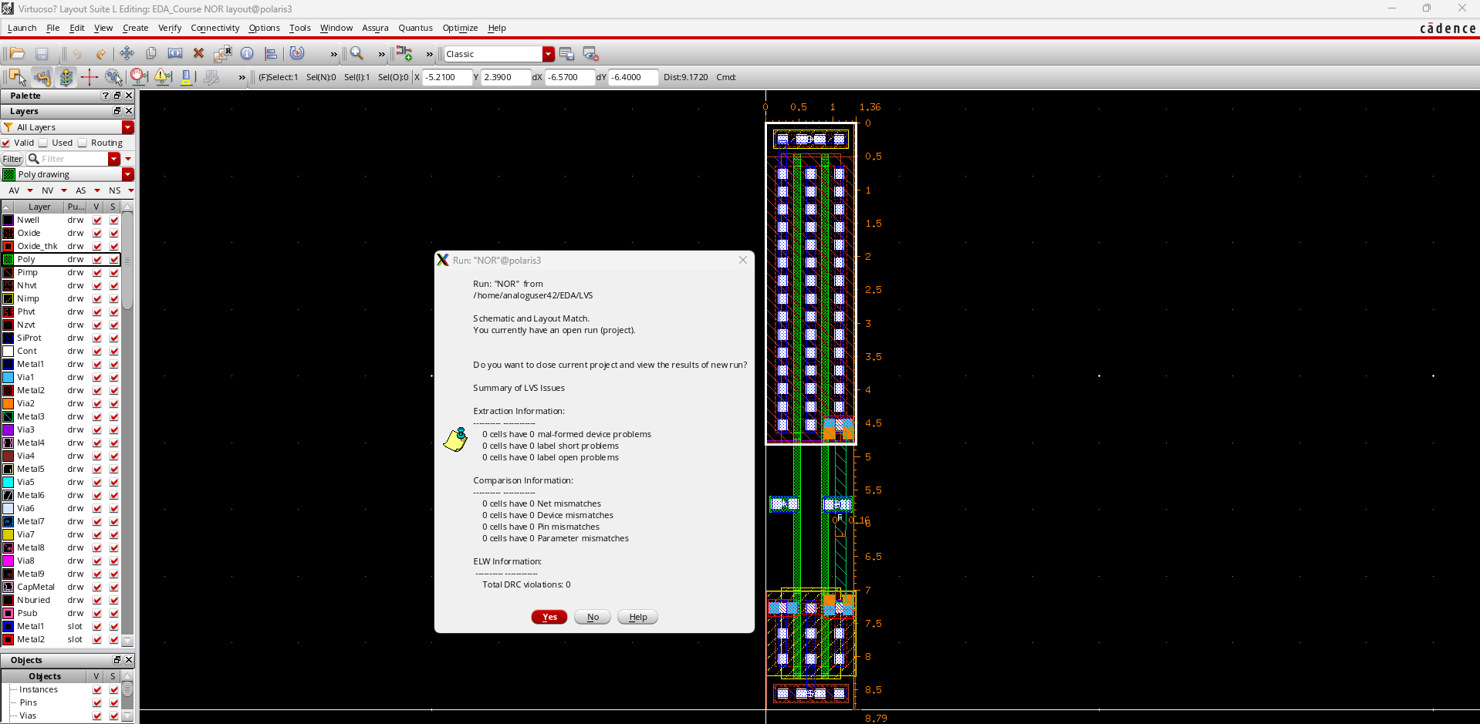
LVS 결과

Slide 9
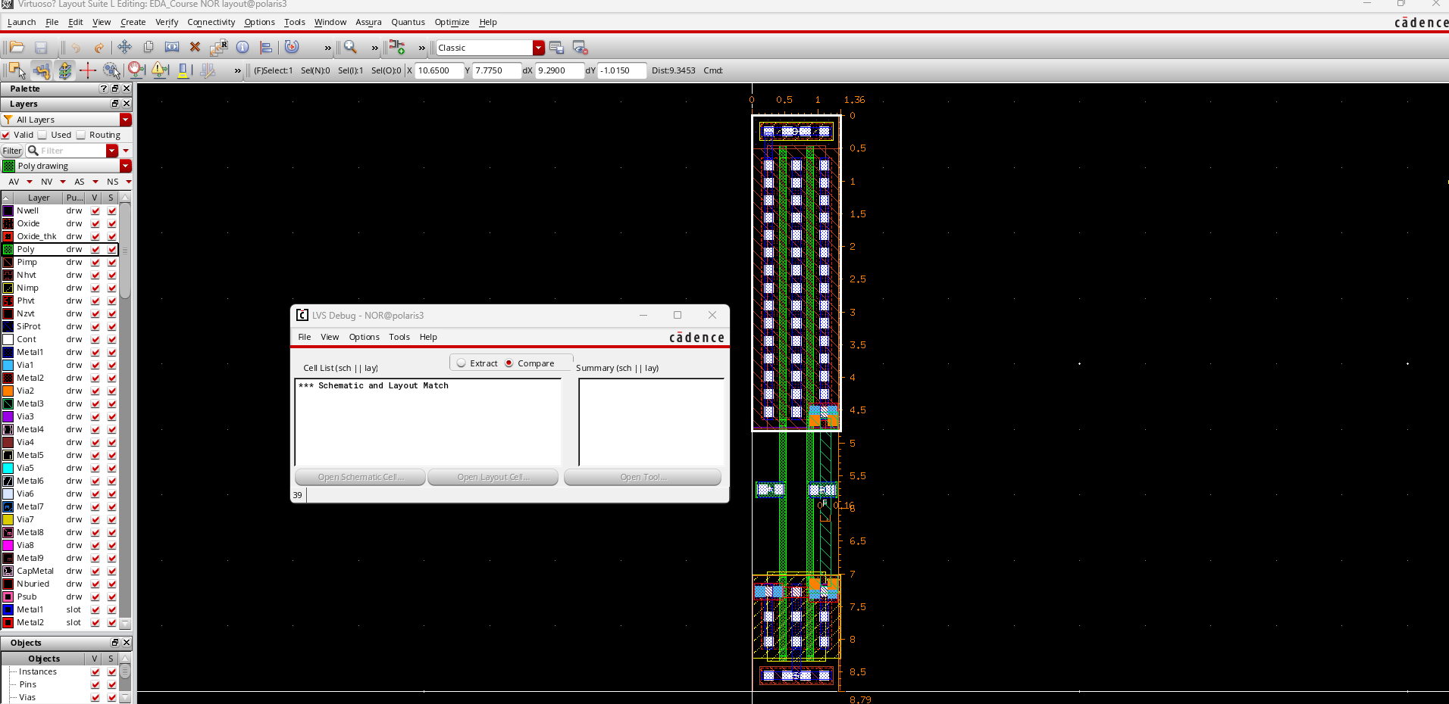
LVS 결과

Slide 10
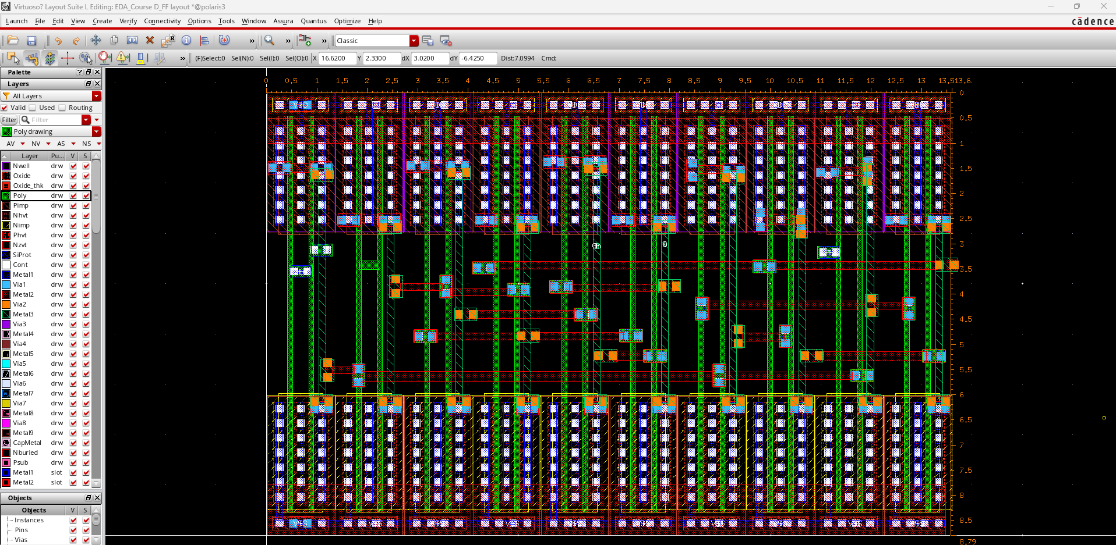
Master-Slave D-F/F 경로:/home/analoguser42/EDA/EDA_Course
Library: EDA_Course
Master-Slave D-F/F schematic : cell name ==> D_FF, view name ==> layout
(가로X높이)
=(13.6X8.79)=119.54

Slide 11
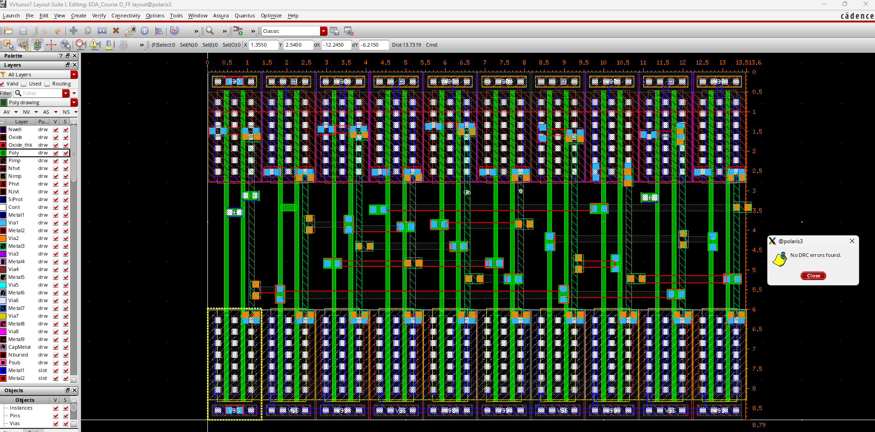
DRC 결과

Slide 12
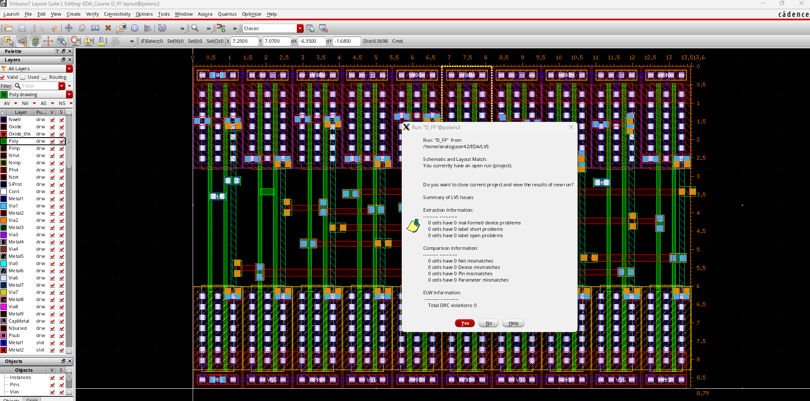
LVS 결과

Slide 13
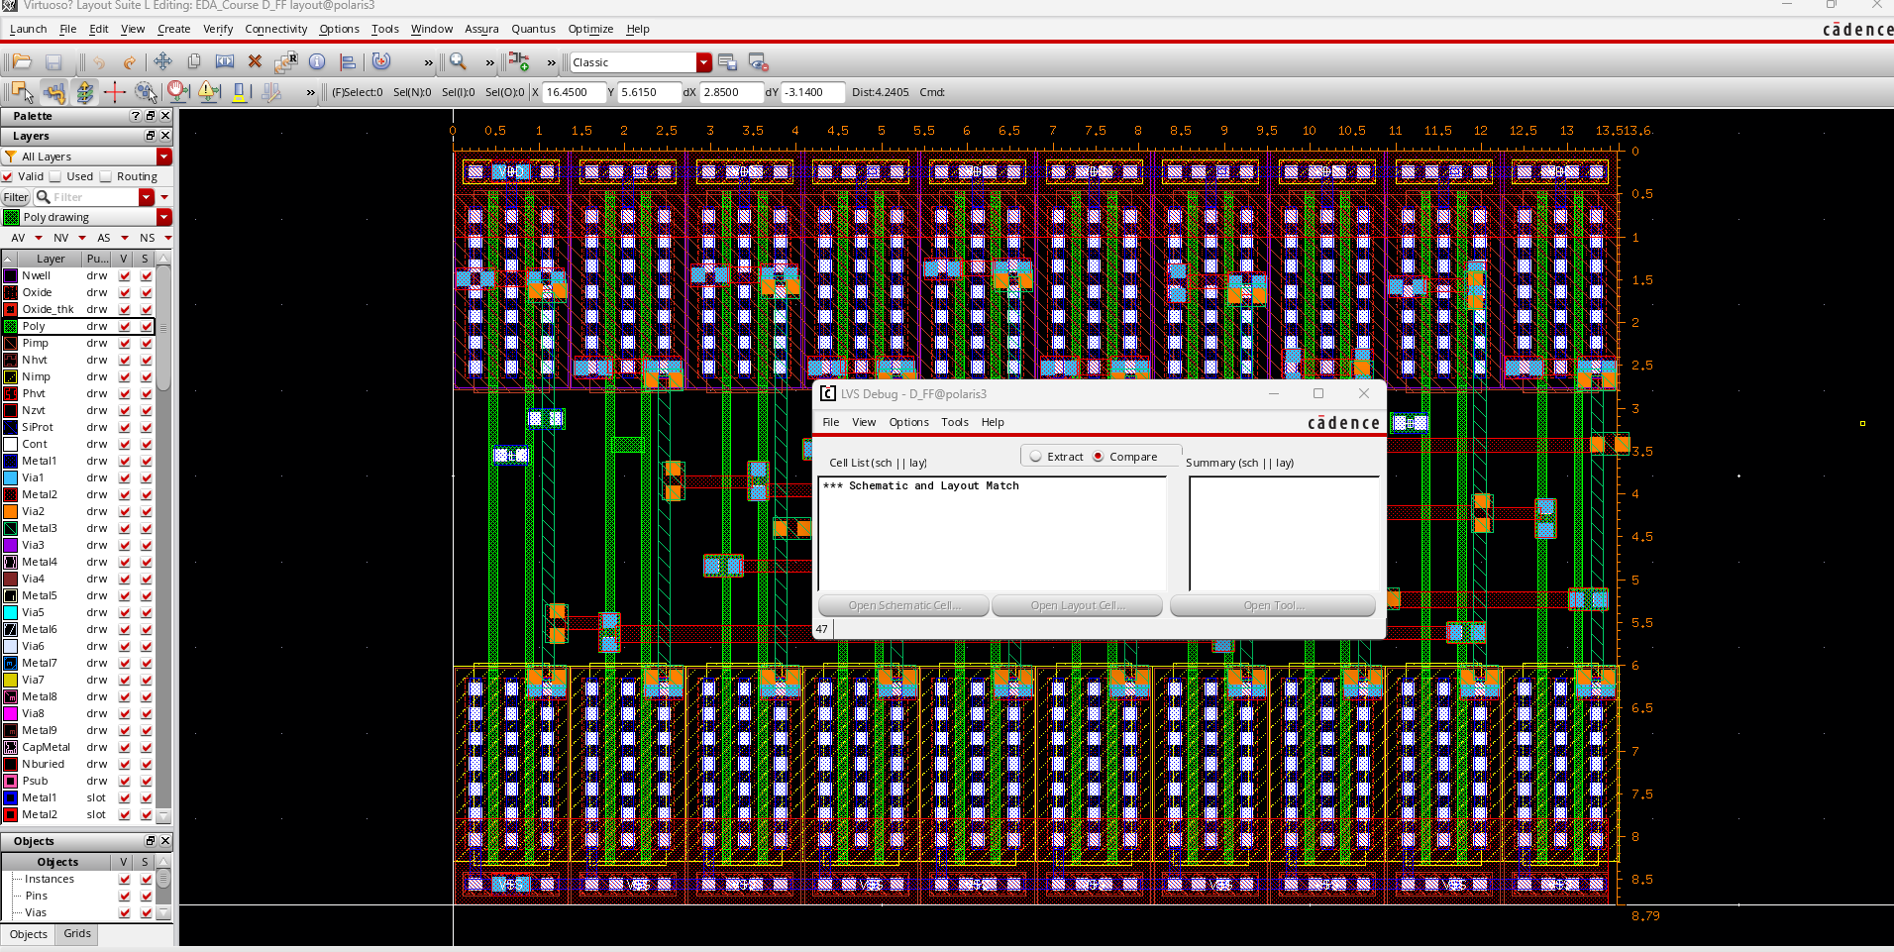
LVS 결과

Slide 14
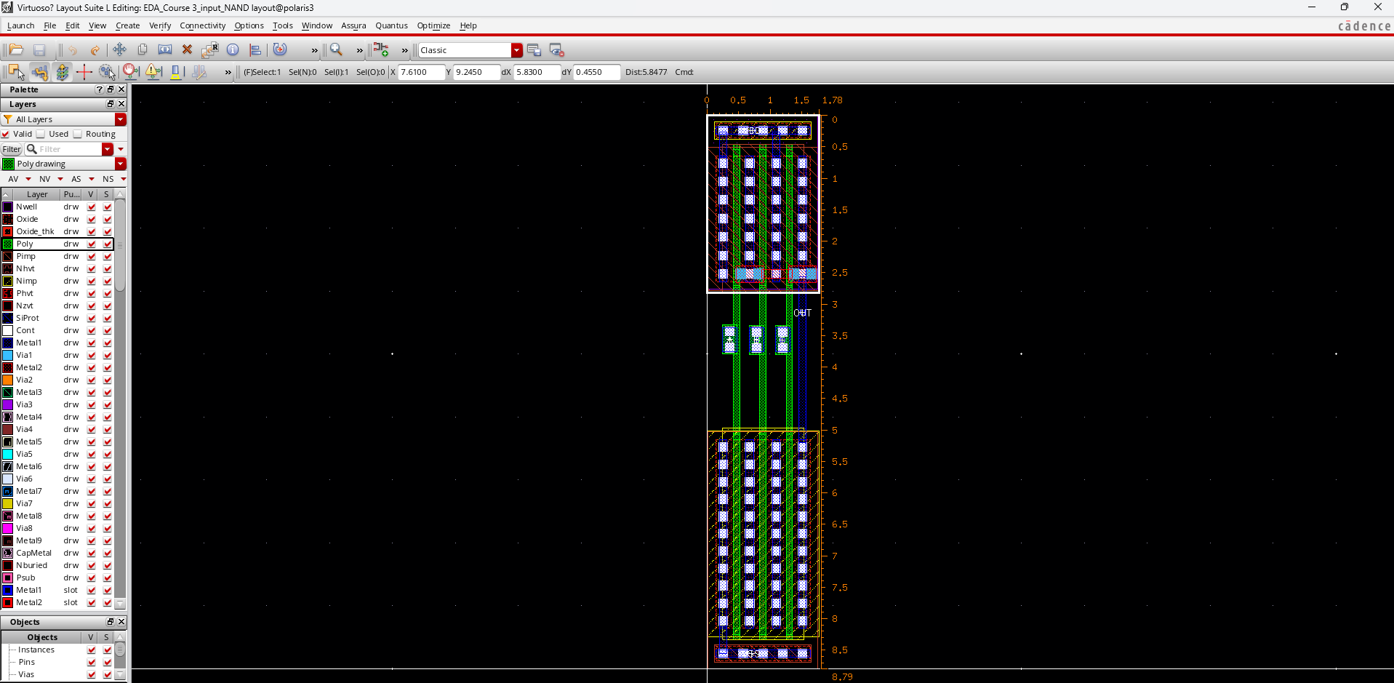
3-input NAND 경로:/home/analoguser42/EDA/EDA_Course
Library: EDA_Course
3-input NAND schematic : cell name ==> 3_input_NAND, view name ==>layout
(가로X높이)
=(1.78X8.79)=15.64

Slide 15
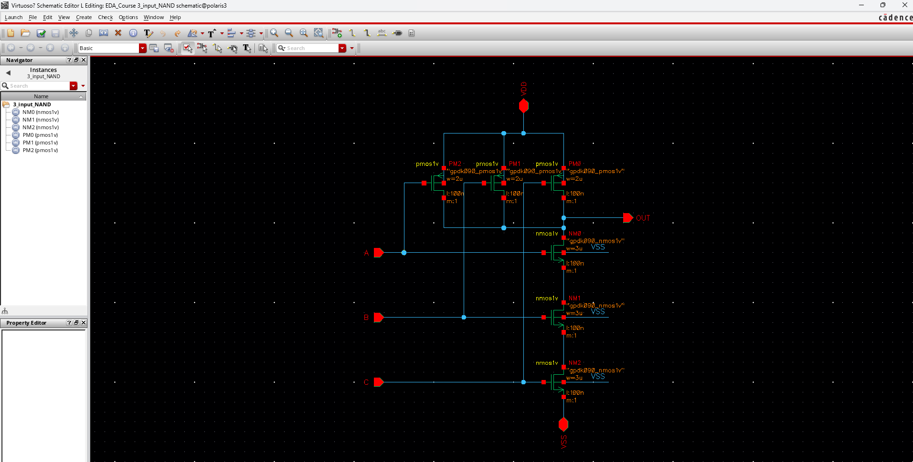
schematic
3-input NAND 경로:/home/analoguser42/EDA/EDA_Course
Library: EDA_Course
3-input NOR schematic : cell name ==> 3_input_NAND, view name ==> schematic

Slide 16
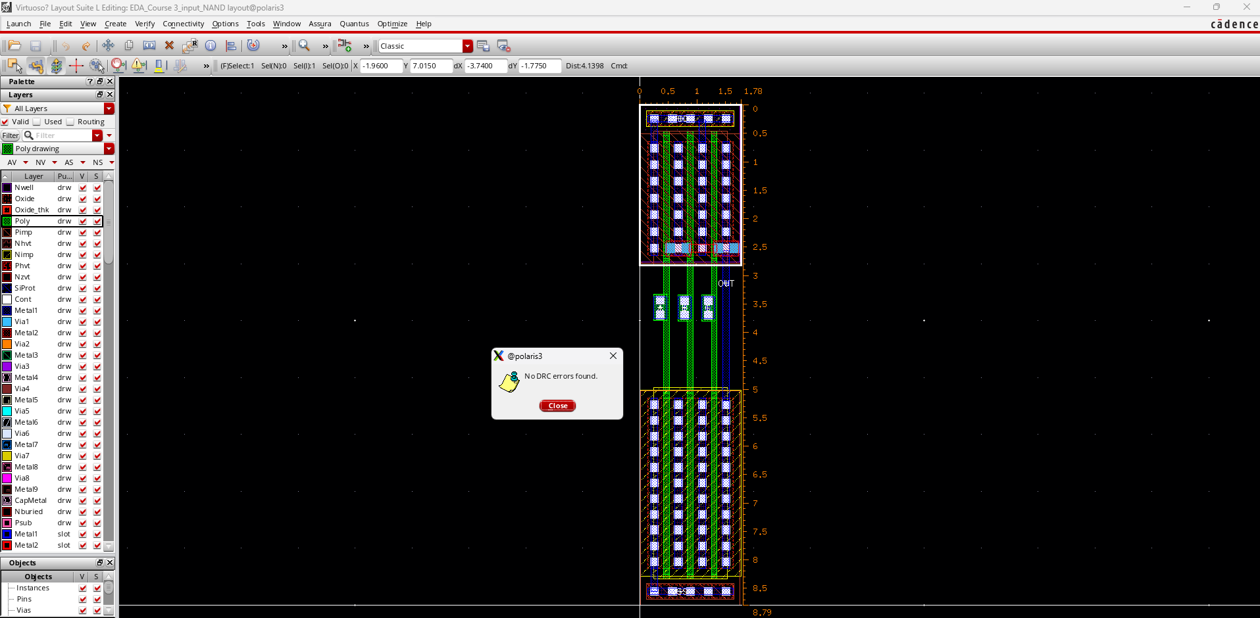
DRC 결과

Slide 17
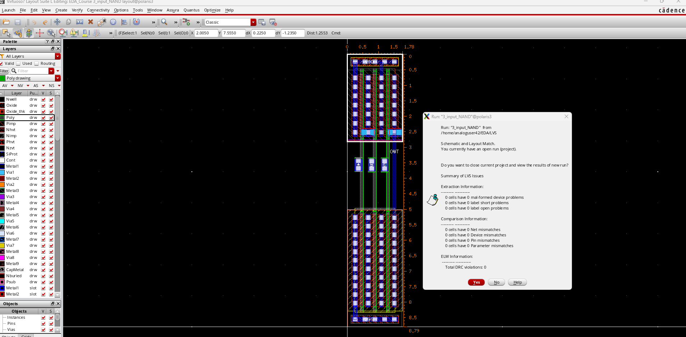
LVS 결과

Slide 18
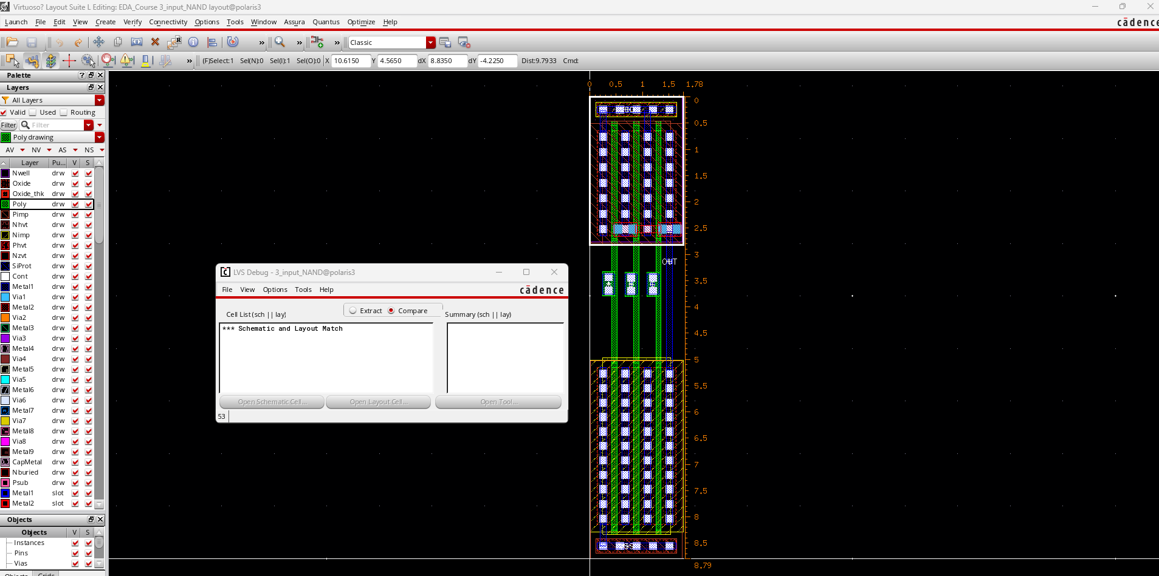
LVS 결과

Slide 19
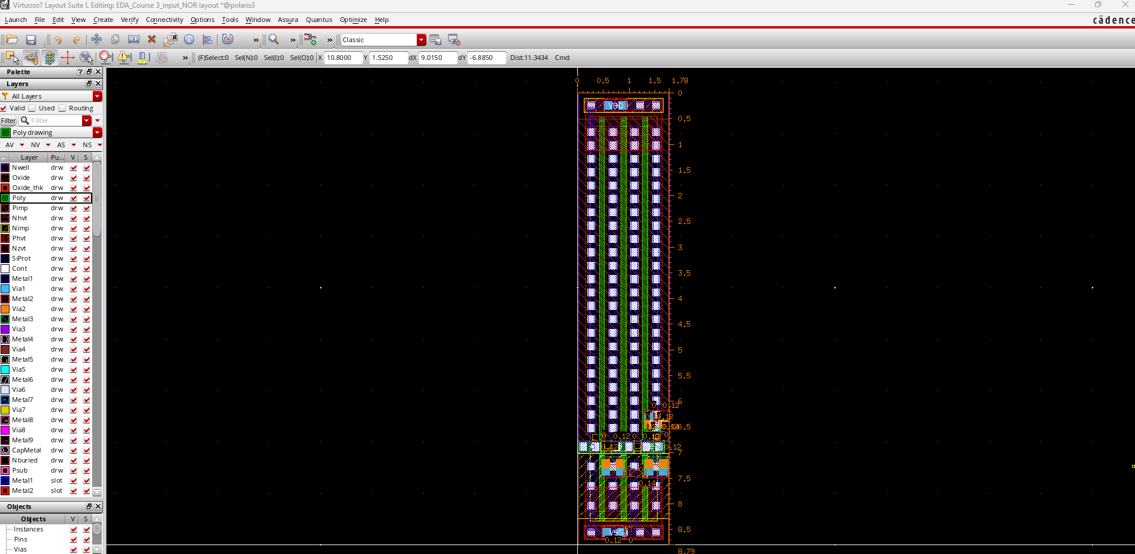
3-input NOR 경로:/home/analoguser42/EDA/EDA_Course
Library: EDA_Course
3-input NOR schematic : cell name ==> 3_input_NOR, view name ==> layout
(가로X높이)
=(1.78X8.79)=15.64

Slide 20
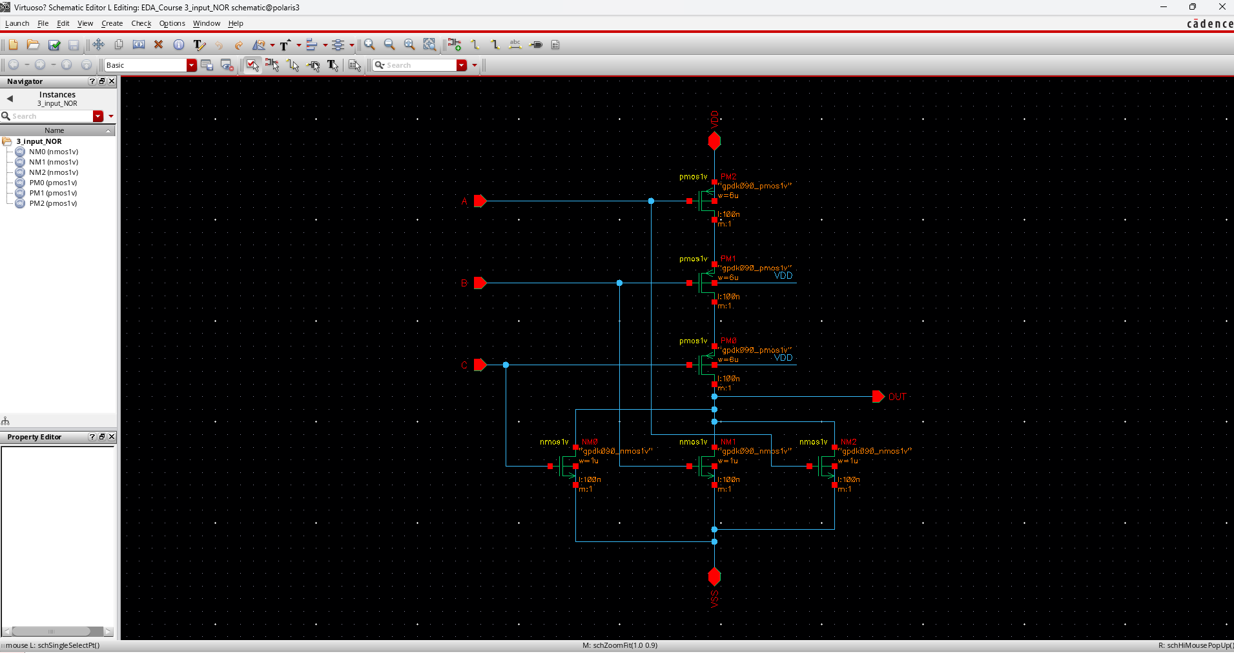
schematic
3-input NOR 경로:/home/analoguser42/EDA/EDA_Course
Library: EDA_Course
3-input NOR schematic : cell name ==> 3_input_NOR, view name ==> schematic

Slide 21
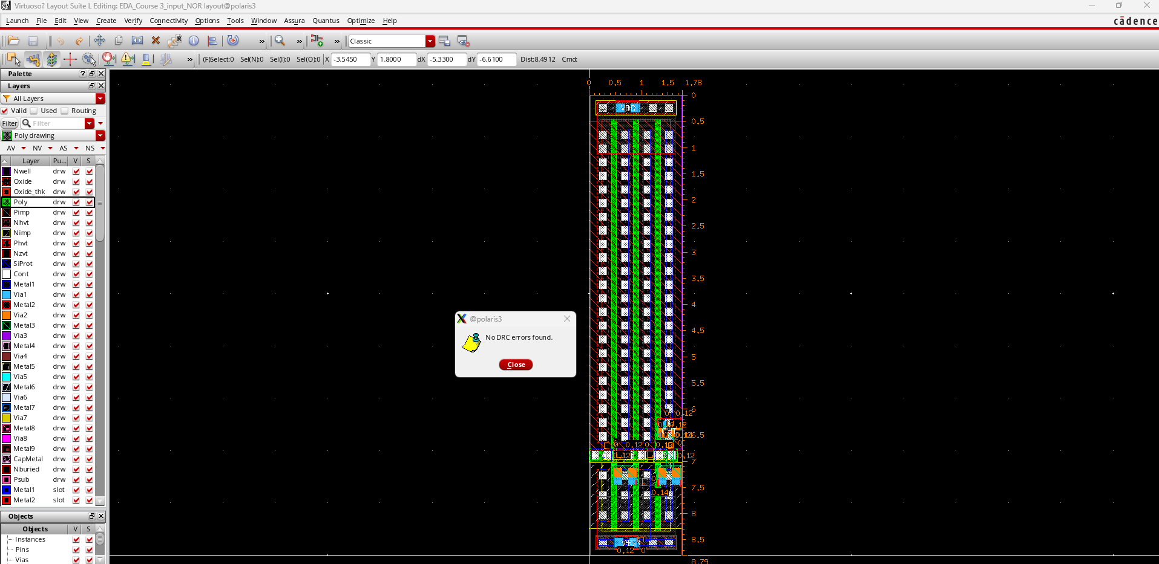
DRC 결과

Slide 22
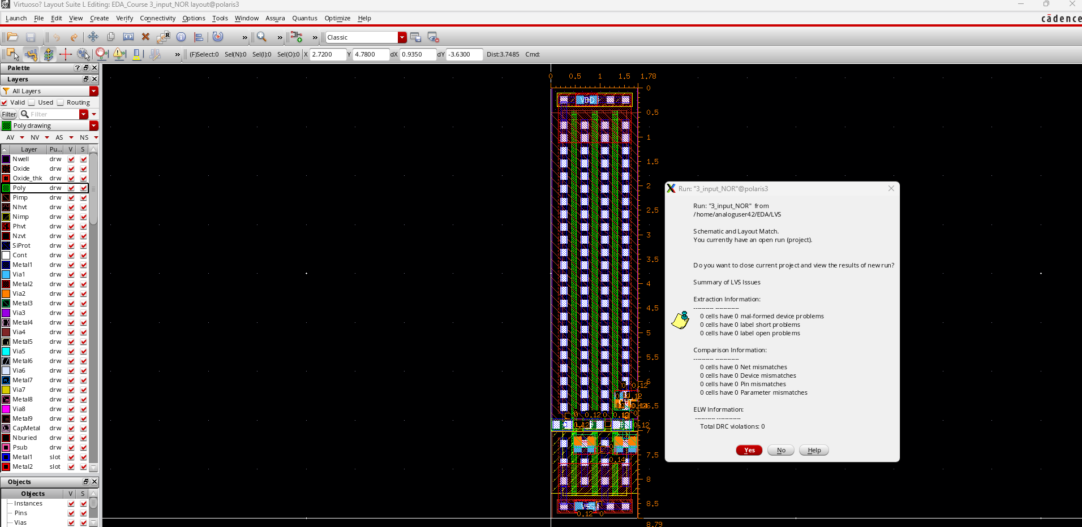
LVS 결과

Slide 23
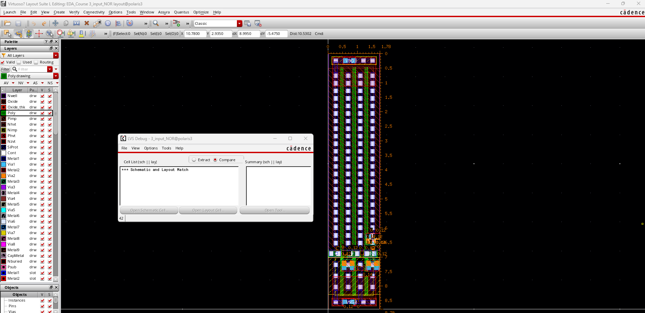
LVS 결과

Slide 24
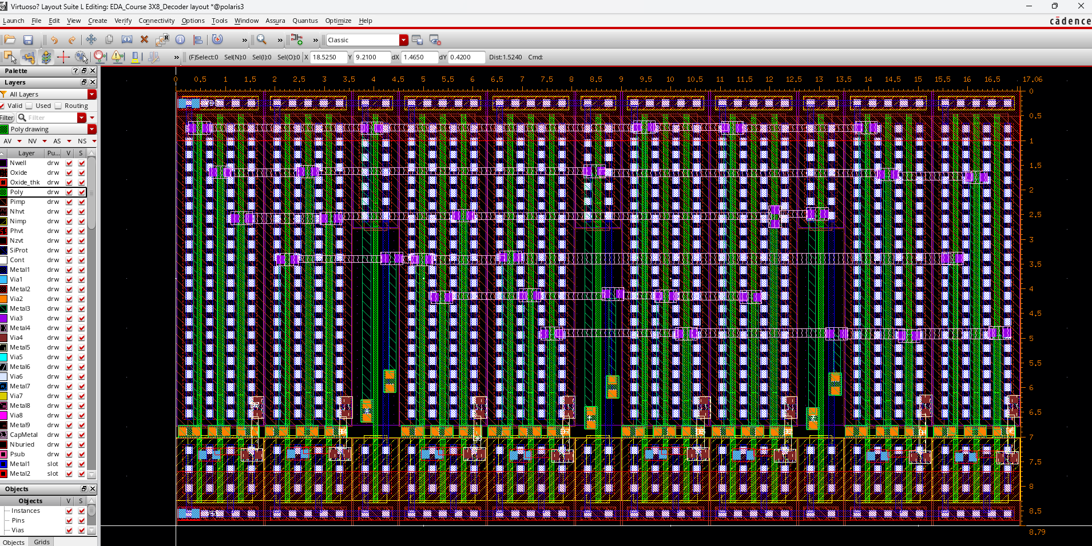
3X8_Decoder 경로:/home/analoguser42/EDA/EDA_Course
Library: EDA_Course
3X8_Decoder schematic : cell name ==> 3X8_Decoder, view name ==> layout
(가로X높이)
=(17.06X8.79)
=149.95

Slide 25
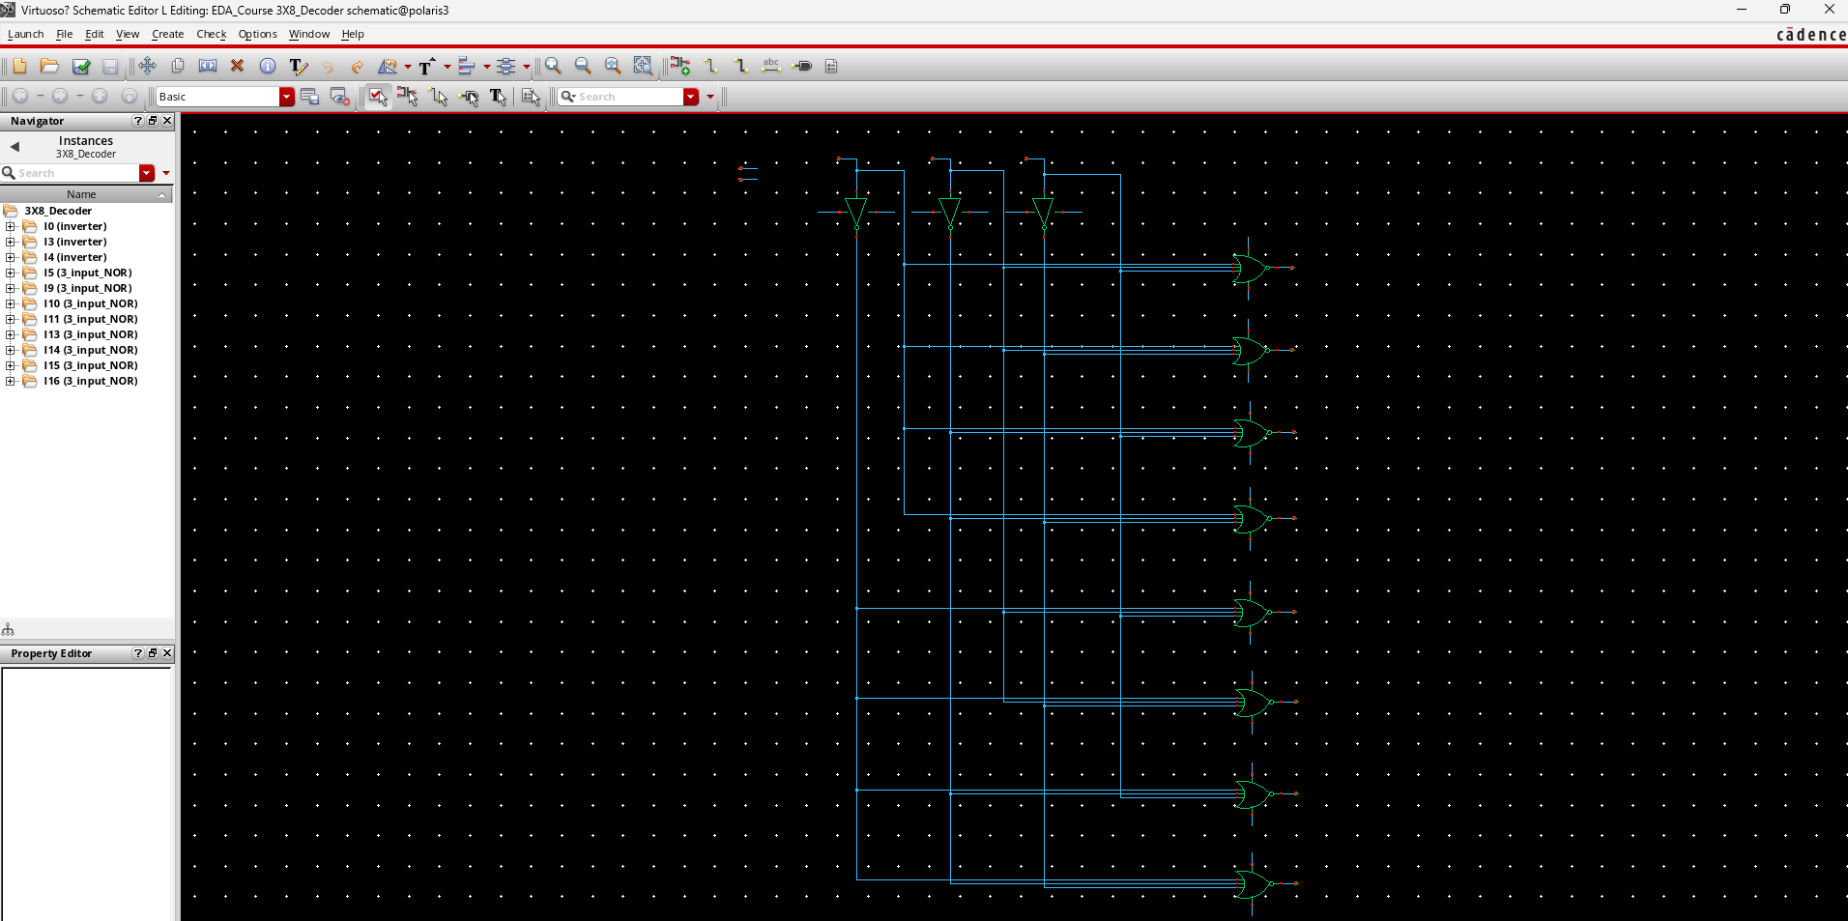
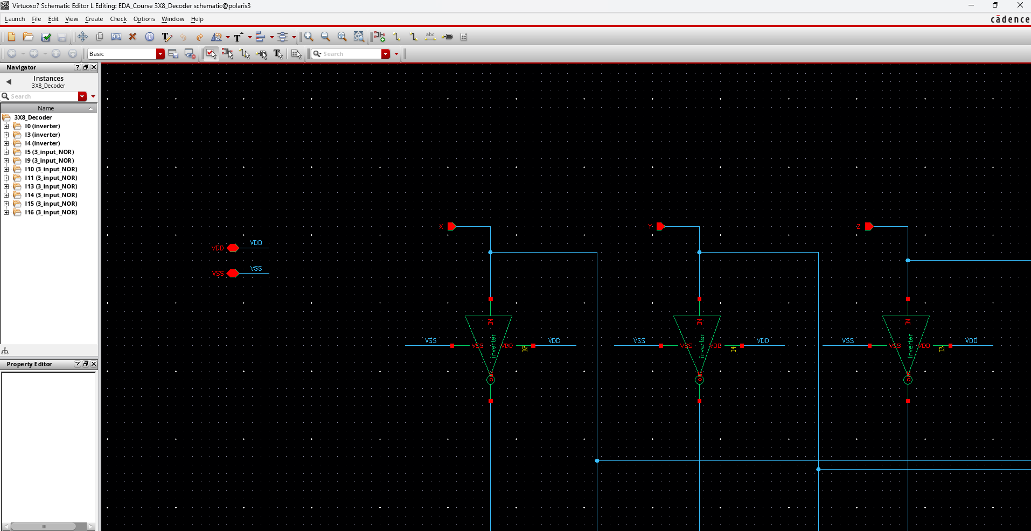
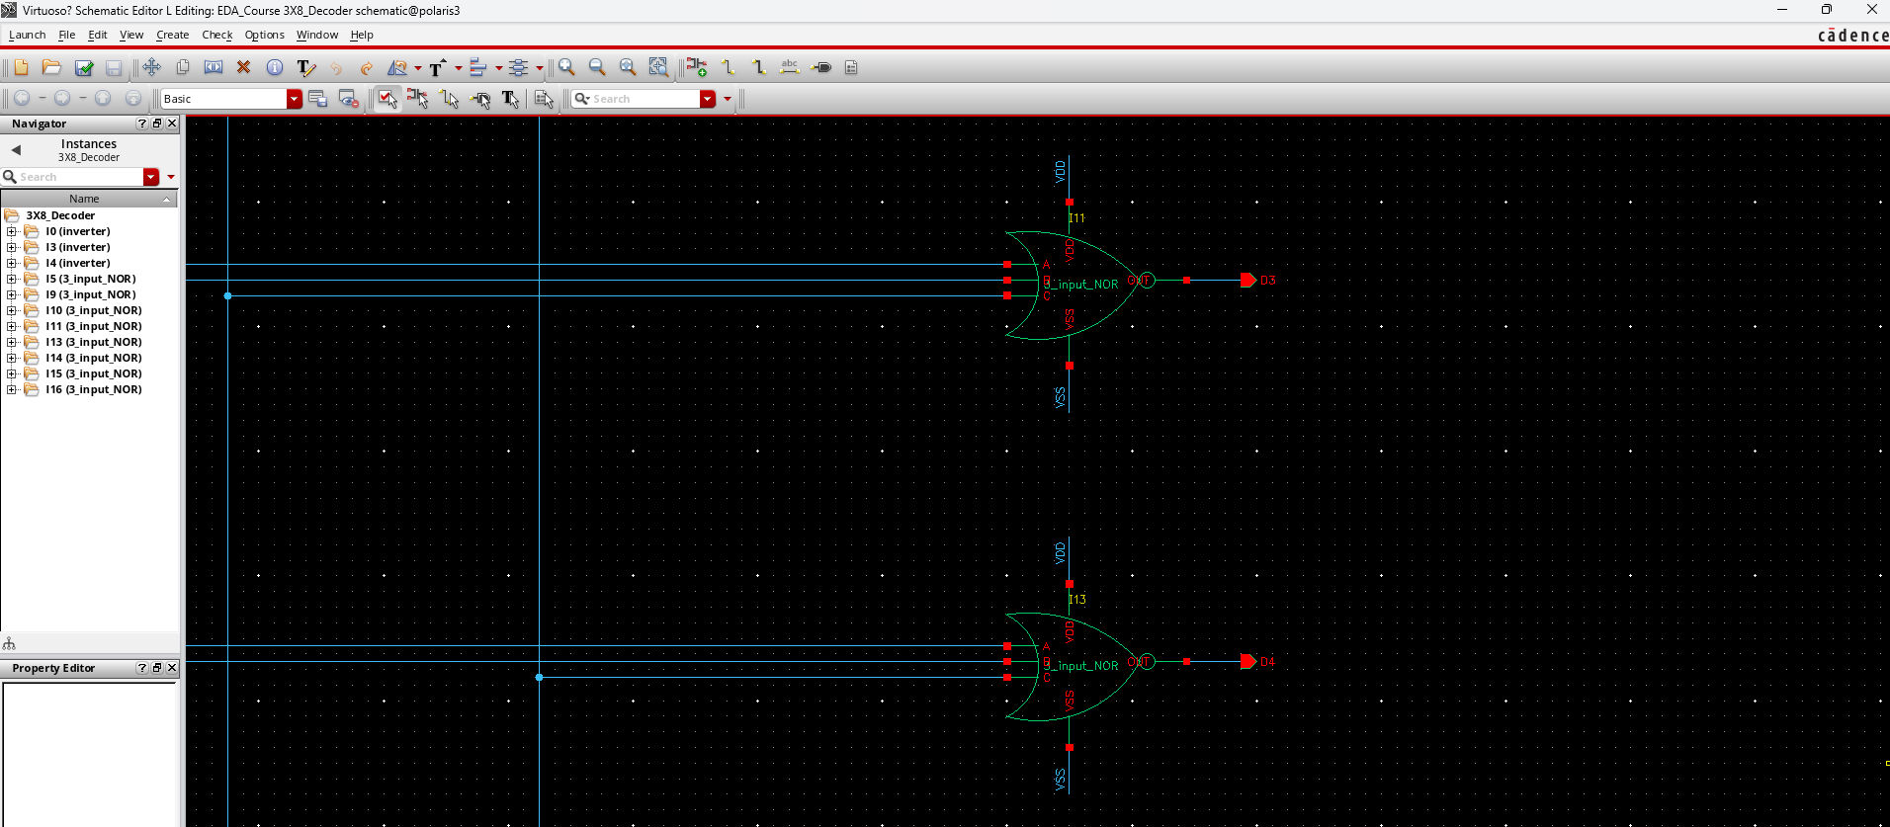
schematic
3X8_Decoder 경로:/home/analoguser42/EDA/EDA_Course
Library: EDA_Course
3X8_Decoder schematic : cell name ==> 3X8_Decoder, view name ==> schematic

Slide 26
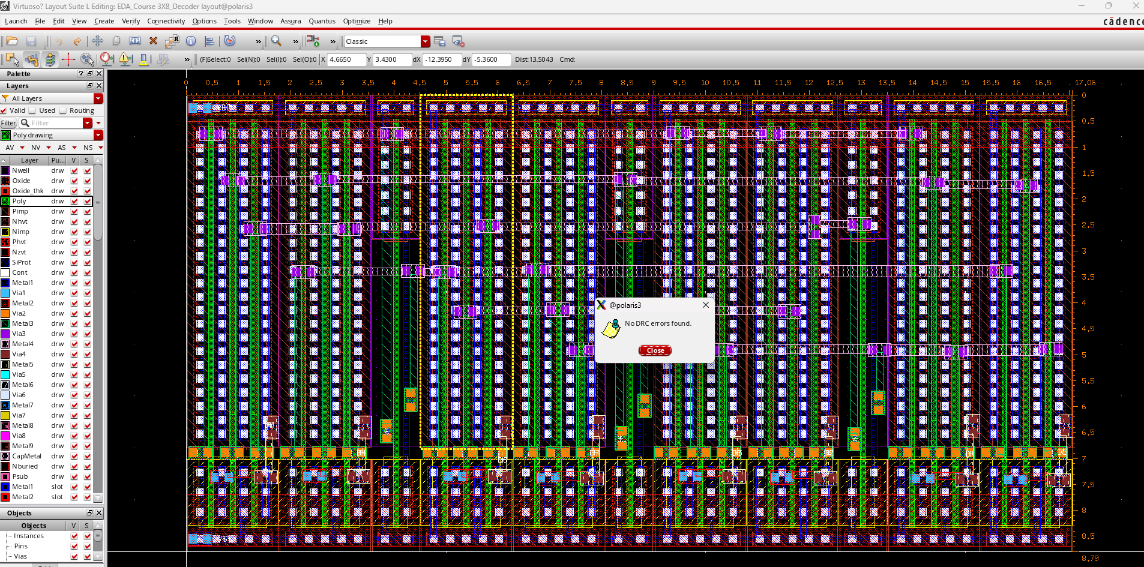
DRC 결과

Slide 27
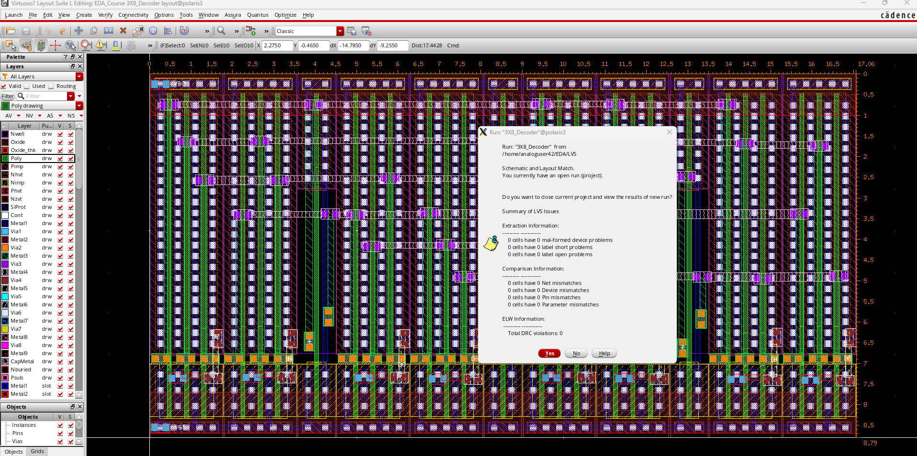
LVS 결과

Slide 28
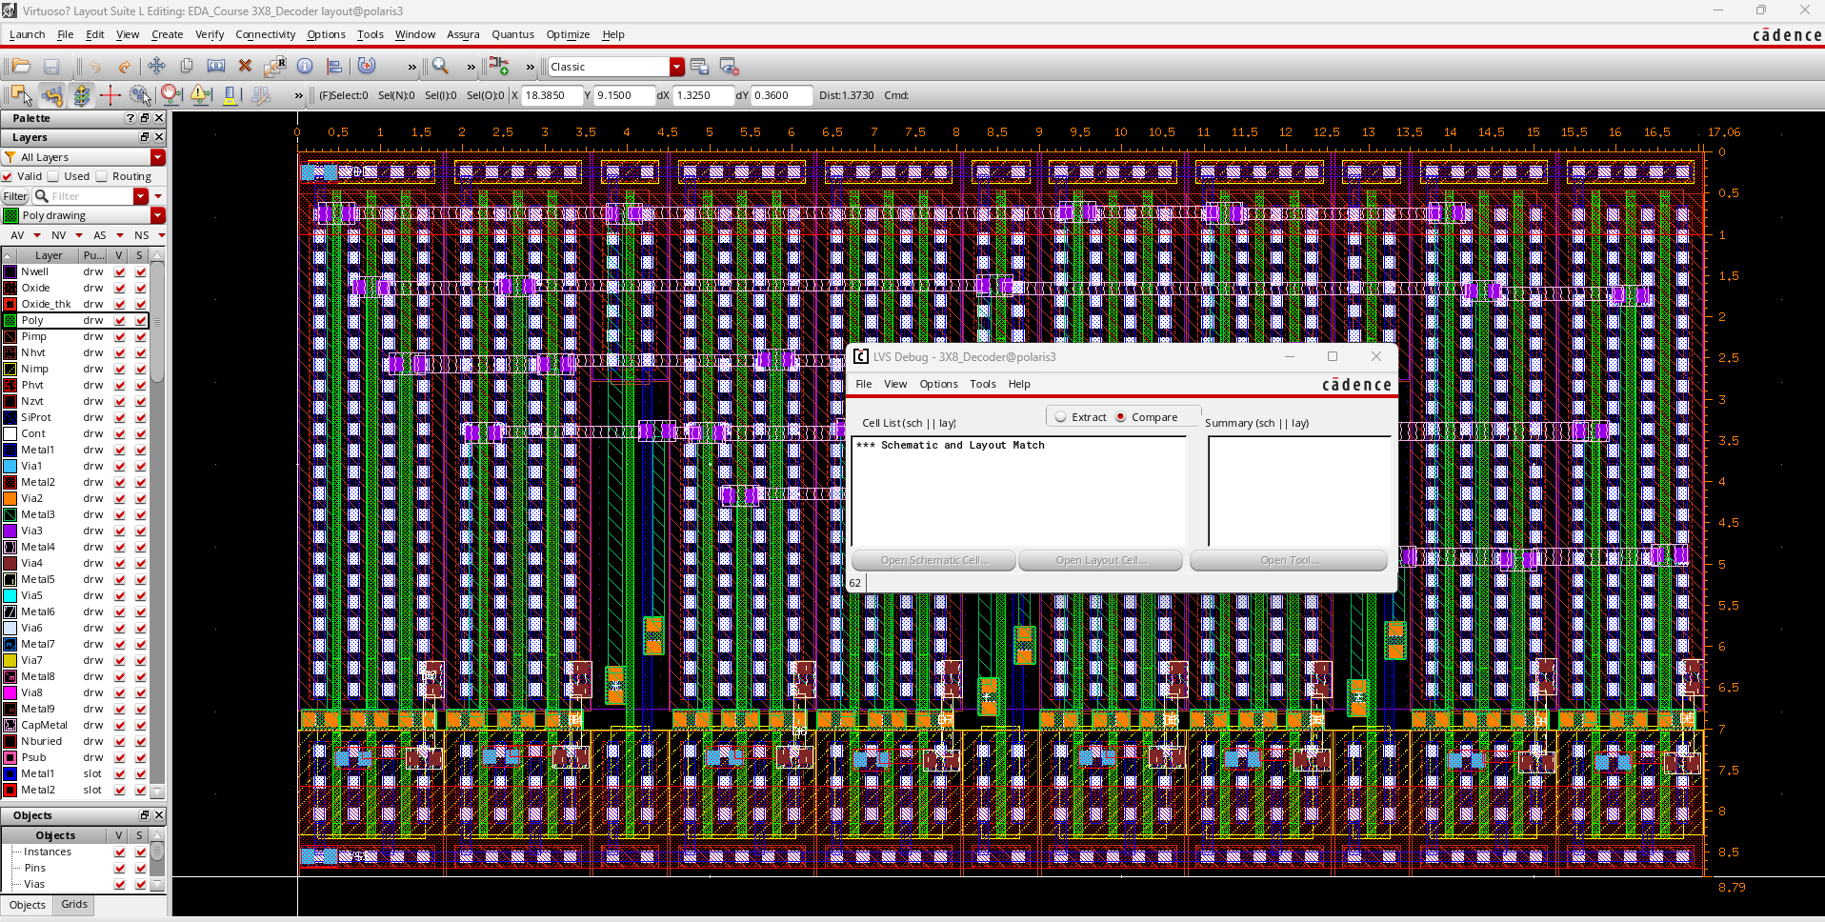
LVS 결과

Slide 29
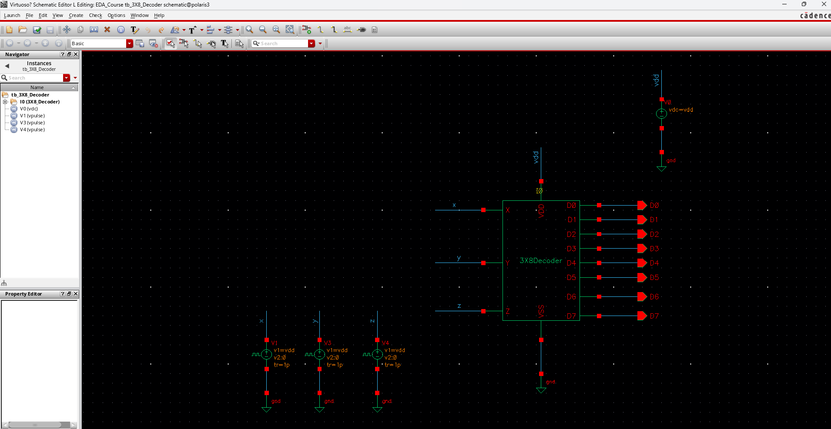
3X8_Decoder 경로:/home/analoguser42/EDA/EDA_Course
Library: EDA_Course
3X8_Decoder testbench : cell name ==> tb_ 3X8_Decoder , view name ==>schematic
state view name ==> spectre_state_tran
3X8_Decoder simulation 결과
- Testbench Schematic

Slide 30
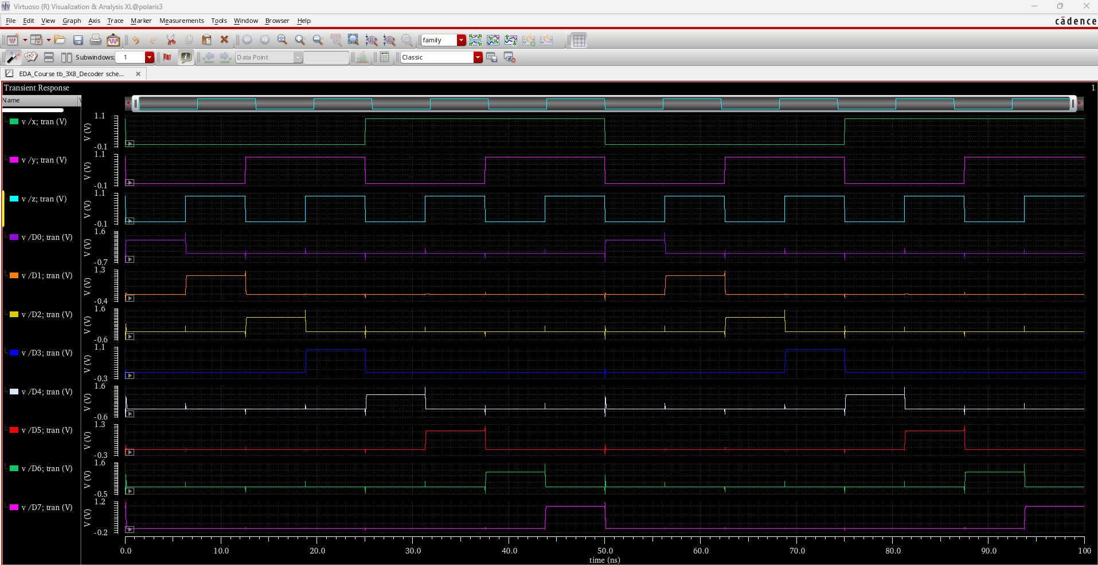
-Simulation

